Slide 1
What are source systems?
Business Intelligence & Analytics

Slide 2
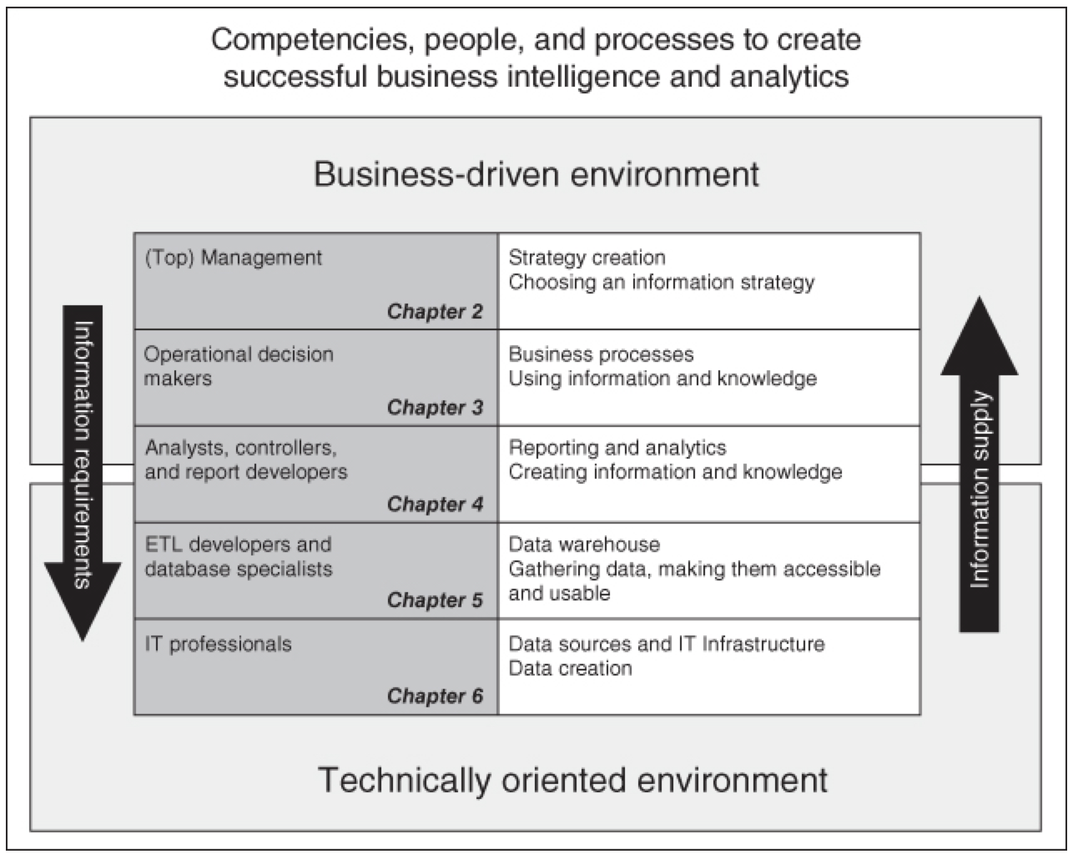

Slide 3
What is a source system?
Source System
Data sources on which a data warehouse is based
Many times there are several data warehouses integrated in such a way that one data warehouse can serve as a source system for another
Data-generating System
Systems that create data the first time
Many are front-end operational systems
Not in the data warehouse
Notes:
Checkout register as an example

Slide 4
Billing systems
FreshBooks
Tipalti
Sage 50 Cloud
Zoho Books
Quickbooks Enterprise
Sage Business Cloud
Xero
Print bills to named customers
Used for behavior-based segmentations
Value-based segmentations
https://financesonline.com/top-10-billing-software-systems/

Slide 5
Social media data
Facebook
Twitter
Instagram
Other??
Public and key influencer perception
Text mining for sentiment analysis
Track social media attention against sales
Who has an impact on company perception
Notes:
Note that sentiment analysis is done using databases of coded words and biases can be inherent in those databases.

Slide 6
CRM systems
HubSpot CRM
Salesforce CRM
Freshsales
Pipedrive
OnContact
Customer contact history (email, phone)
Progress through sales cycle
Support tickets (sometimes)
Customer value analysis
Sales funnel analysis

Slide 7
Product and consumption information
Custom database solutions
Web tracking systems (Adobe Analytics, Google Analytics)
Which products are used over time
Product feature use
Churn predictions (in some cases)

Slide 8
Human Resources systems
BambooHR
Zoho People
Dayforce HCM
SAP SuccessFactors
Kronos Workforce Central
Optimization of the people side of the business
Hiring and retention
hours worked and timesheets
Org structure
https://financesonline.com/top-20-hr-software-solutions/

Slide 9
Analytics information
KPIs
Used for monitoring purposes
If saved and snapshotted correctly can be used for optimization later on
Data mining results
Or other analytics projects
Segmentations, sales models, loyalty segmentation
Used to create learning about causal relations across the business

Slide 10

Difference between source systems and data-generating systems
List of source systems and how they would be used

Slide 11


